Slide 1
IBM Urban Code Deploy

Slide 2
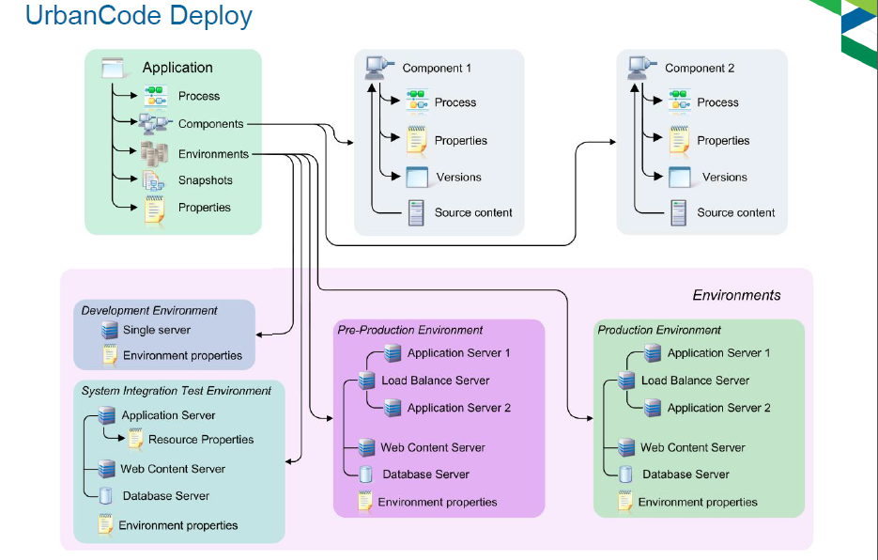

Slide 3
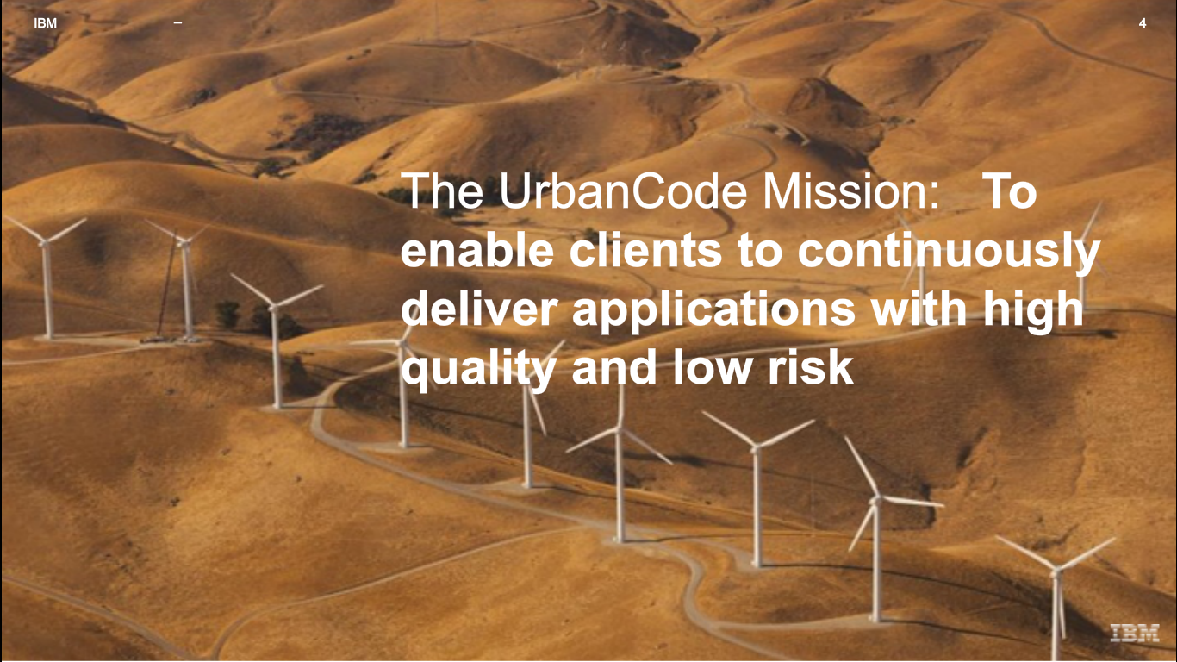

Slide 4
